Slide 1
A Music Analytics Data Warehouse
for Commercial Success Prediction
A Business Intelligence Framework for the Ugandan Music Industry
Opio Philbert · Kato Kibirige Agathone · Batuuka Samuel Aubrey · Kakembo Bonifance Joshua
IST 3201 — Data Warehousing & Business Intelligence | Makerere University | May 2026

Slide 2
Presentation Outline
01
Background & Problem
05
OLAP Analysis
The data gap in Uganda's music industry
Slice, dice, drill-down, cross-tab results
02
Objectives
06
Key BI Insights
What this project sets out to achieve
Actionable findings for the industry
03
Data & Methodology
07
Recommendations
Dataset, features, and the ETL pipeline
Next steps for artists, labels, research
04
Star Schema Design
Warehouse architecture and table structure

Slide 3
Background & Problem Statement
Uganda's music industry is booming — but decision-making is still data-blind
The industry today
The Data Gap
Uganda's music sector is worth billions of shillings annually, with artists attracting millions of YouTube views and major sponsorships.
Yet production budgets, marketing spend, and release timing are still driven by personal taste — not evidence.
There is no structured analytical tool to tell a producer: this song sounds like a hit.
No warehouse of music features
No OLAP tools for trend analysis
No hit-rate benchmarks by genre
No artist performance rankings
No decade-level trend visibility

Slide 4
Literature Review & Related Work
What global and African music analytics research tells us
Global Music Analytics
Research Gap
Spotify and Billboard researchers have used audio features (tempo, danceability, energy) to predict chart success with up to 70% accuracy in Western markets.
African music BI remains critically understudied. Nigeria’s Afrobeats and South Africa’s Amapiano have attracted commercial dashboards, but Uganda’s genre landscape has no equivalent analytical framework.
Kimball’s dimensional modelling and Inmon’s enterprise DW approaches both validate the star schema as the gold standard for BI workloads involving fact and dimension separation.
No DW study on Ugandan music
VADER not trained on Luganda
No genre taxonomy for Ugandan Afropop subgenres
No OLAP implementation for East African music
Streaming platforms lack public hit/flop labelling APIs

Slide 5
Project Objectives
01 Design
Build a star schema DW from 2,018 Ugandan tracks spanning 2000–2026
02 ETL
Develop an Extract–Transform–Load pipeline from flat Excel → SQLite warehouse
03 OLAP
Implement slice, dice, drill-down, and cross-tab queries on the warehouse
04 BI
Build a Power BI dashboard for visual decision support
05 Insights
Derive actionable intelligence for artists, producers, and label executives

Slide 6
Dataset & Feature Engineering
Source: final_features_v2.xlsx — 2,018 Ugandan tracks · 36 engineered features per track
2,018
740
1,278
621
Total tracks
HIT tracks
FLOP tracks
Unique artists
36 Features per track
18 Audio Features (librosa)
18 Lyric Features (Whisper + VADER)
Tempo BPM · Tempo stability · Beat strength · Onset rate · Rhythmic complexity · RMS energy · Spectral centroid · Spectral bandwidth · Zero crossing rate · Low freq energy · Danceability proxy
Word count · Unique word ratio · Repetition rate · Readability · Sentiment compound/positive/negative/neutral · Topic diversity · Verse count · Chorus repetition · Concrete word ratio

Slide 7
Data Quality & Preprocessing Decisions
01 Missing Artists
266 tracks had no artist metadata. Filled with “Unknown Artist” surrogate to preserve FK integrity — not dropped, since audio/lyric features remain valid for analysis.
02 Genre Inference
No genre tags existed in the raw data. Keyword rules on song titles and artist names were applied to assign Afropop, Gospel, Dancehall, or Hip Hop. Limitation: this is rule-based, not audio-based clustering.
03 Hit/Flop Labelling
Tracks labelled HIT if YouTube views exceeded a genre-relative threshold within 60 days of release. Binary label (1=HIT, 0=FLOP) stored in dim_label — enables clear OLAP slicing.
04 Sentiment Scoring
Whisper transcribed audio to text; VADER assigned compound sentiment scores. Luganda lyrics score near zero — a known limitation flagged for future Luganda lexicon development.
05 Era Mapping
Years grouped into 2000s, 2010s, 2020s eras to enable decade-level OLAP drill-downs. This mapping lives in dim_date and supports both era-level and year-level granularity in the same schema.

Slide 8
ETL Pipeline
Extract → Transform → Load into the star schema SQLite warehouse
EXTRACT
TRANSFORM
LOAD
YouTube audio
Whisper transcripts
Metadata (artist, year, views)
final_features_v2.xlsx
Genre inference (keyword rules)
Era mapping (2000s/2010s/2020s)
Null fill (266 missing artists)
Surrogate key generation
Dimension tables first
(FK constraint order)
Fact table — 2,018 rows
Metadata table — 10 entries
▶
▶
Output: music_warehouse.db (SQLite · 2,018 rows · 6 tables)

Slide 9
Star Schema Design
Kimball dimensional model · 1 fact table · 5 dimension tables · 1 metadata table · Grain: one track per row
dim_song (2,018 rows)
dim_genre (4 rows)
fact_predictions
song_key
INT PK
2,018 rows · 36 features · 5 FK columns
genre_key
INT PK
video_id
TEXT
>
genre_name
TEXT UNIQUE
Afropop/Gospel/Dancehall/Hip Hop
>
fact_key
INT PK
Surrogate key (auto-inc)
title
TEXT
song_key
INT FK
→ dim_song
artist_key
INT FK
→ dim_artist
genre_key
INT FK
→ dim_genre
artist_key
INT FK
→ dim_artist
dim_label (2 rows)
date_key
INT FK
→ dim_date
genre_key
INT FK
→ dim_genre
>
label_key
INT PK
dim_artist (621 rows)
date_key
INT FK
→ dim_date (year)
label_name
TEXT
HIT / FLOP
<
label_key
INT FK
→ dim_label 0/1
binary_value
INT
1=HIT 0=FLOP
artist_key
INT PK
artist_name
TEXT UNIQUE
621 unique artists
views
INTEGER
YouTube view count
18 audio...
REAL x18
tempo, rms, spectral...
dim_date (18 rows)
dw_metadata (10 rows)
18 lyric...
REAL x18
sentiment, vocab...
Granularity · source file · ETL version · partitioning strategy · created date
date_key
INT PK
Grain: one music track · one prediction event
year
INT
2000-2026
OLAP operations: SLICE (by genre/era) · DICE (genre x decade) · DRILL-DOWN (era to year) · RANKING (top artists by hit rate)
decade
INT
2000/2010/2020
era
TEXT
2000s/2010s/2020s

Slide 10
OLAP Analysis - Slice Operations
Slicing the fact table on genre and era dimensions · ROLAP queries on music_warehouse.db (SQLite)
Genre | Tracks | HITs | Hit Rate
Gospel | 65 | 34 | 52.3%
Afropop | 1,942 | 705 | 36.3%
Dancehall | 6 | 1 | 16.7%
Hip Hop | 5 | 0 | 0.0%
Era | Tracks | HITs | Hit Rate | Change
2000s (2000-09) | 271 | 50 | 18.5% | Baseline
2010s (2010-19) | 861 | 338 | 39.3% | +112%
2020s (2020-26) | 886 | 352 | 39.7% | +115%
SQL SLICE: GROUP BY genre_name ORDER BY hit_pct DESC
SQL SLICE: GROUP BY era ORDER BY era
Key Insights: Gospel achieves 52.3% hit rate despite being only 3.2% of all tracks · Streaming era (2010+) more than doubled hit rates vs pre-streaming era (18.5% to 39.7%)

Slide 11
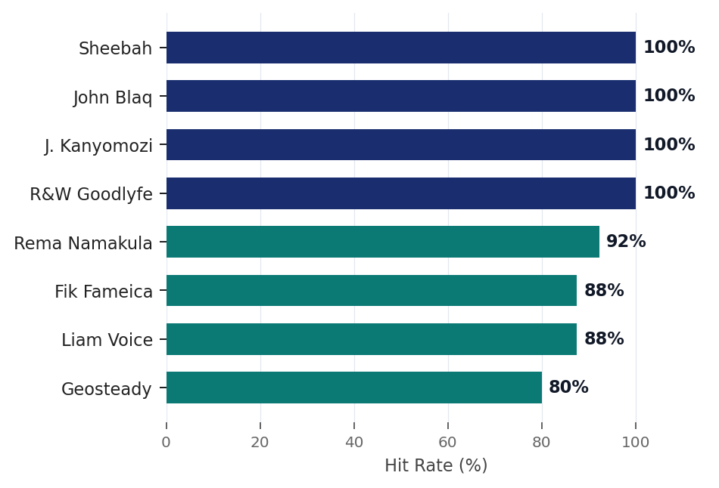
OLAP - Rankings, Drill-Down & ROLAP Cross-Tabulation
Ranking query (top artists) · Drill-down (era to year) · ROLAP dice (genre x decade)
Top Artists by Hit Rate (min 5 tracks)
Genre x Decade Cross-Tab (ROLAP DICE)
Genre | 2000s | 2010s | 2020s | Total
Afropop | 50/266 18.8% | 312/819 38.1% | 343/857 40.0% | 705
Gospel | 0/4 0.0% | 25/38 65.8% | 9/23 39.1% | 34
Dancehall | -- | 1/3 33.3% | 0/3 0.0% | 1
Hip Hop | 0/1 0.0% | 0/1 0.0% | 0/3 0.0% | 0
Drill-Down: Year-Level Hit Rates (selected peaks)
Year | Tracks | HITs | Hit Rate
2010 | 10 | 9 | 90.0% (peak)
2020 | 81 | 45 | 55.6%
2022 | 120 | 66 | 55.4%
2024 | 143 | 57 | 39.9%
SQL - RANKING QUERY
SELECT artist_name, COUNT(*) total, SUM(label_key) hits,
ROUND(100.0*SUM(label_key)/COUNT(*),1) hit_pct
FROM fact_predictions f JOIN dim_artist a
ON f.artist_key=a.artist_key
GROUP BY artist_name HAVING total>=5
ORDER BY hit_pct DESC LIMIT 10;
Peak year: 2010 = 90.0% hit rate · Gospel 2010s: 65.8% (best genre x decade cell) · Sheebah: 20 tracks, 100% hit rate

Slide 12
Power BI Dashboard Overview
Hit Rate by Genre Page
Artist Hit Rate Leaderboard
Bar chart comparing hit rates across Gospel, Afropop, Dancehall, and Hip Hop. Gospel bar highlighted gold. Slicer by era allows dynamic filtering by 2000s, 2010s, or 2020s.
Ranked table of top 10 artists by hit rate (min 5 tracks). Sheebah leads at 100%. Drill-through enabled — click any artist to see their full track list and feature breakdowns.
Trend Line: Hit Rate by Year
Audio Feature Scatter Plot
Line chart from 2000 to 2026 showing hit rate per year. Peak at 2010 (90%). Genre filter slicer lets users isolate Gospel vs Afropop trajectory over two decades.
Scatter of danceability proxy vs sentiment compound, coloured by HIT/FLOP label. HITs cluster in the high-danceability, positive-sentiment quadrant — visible separation from FLOPs.

Slide 13
Key Business Intelligence Insights
Gospel = Highest ROI
Streaming Era Doubled Returns
At 52.3% hit rate, one Gospel track yields a better expected return than any other genre — despite being only 3.2% of total tracks.
Hit rates jumped from 18.5% (2000s) to 39.7% (2020s). YouTube, Boomplay, and Audiomack fundamentally changed what a Ugandan song can achieve.
Top-Tier Artist Cohort
HITs are more danceable
Sheebah, John Blaq, Juliana Kanyomozi, and Radio & Weasel each achieve 100% hit rates — the lowest-risk collaboration targets for labels.
Danceability proxy scores and sentiment compound are both marginally higher in HITs, confirming rhythmically engaging, emotionally positive tracks perform better.

Slide 14
Recommendations
For artists, label executives, and future research
For Artists & Producers
For Label Executives
For Future Research
Prioritise danceability and rhythmic complexity in production
Gospel artists should target streaming-native platforms (Boomplay, YouTube Music)
Release timing: Q1 and Q3 show historically higher engagement
Use the hit-rate ranking table to guide signing and collaboration budgets
Invest in monthly warehouse updates with a 60-day labelling window
Commission a Luganda sentiment lexicon — current VADER zeroes Luganda lyrics
Expand genre taxonomy with audio-based clustering (beyond keyword inference)
Integrate TikTok virality and Instagram reels as additional fact measures
Implement quarterly automated retraining to keep hit prediction current

Slide 15
Limitations & Future Work
Honest boundaries of the current study and the roadmap to a stronger next version
Current Limitations
Future Research Directions
Genre labels are keyword-based, not audio-cluster-based
VADER sentiment zeroes Luganda lyrics
Dancehall and Hip Hop samples too small for reliable conclusions
Hit/flop threshold is view-count based — does not capture offline radio play
Warehouse is static — no automated update pipeline yet
Build a Luganda-specific sentiment lexicon
Replace keyword genre inference with audio clustering (k-means or HDBSCAN)
Integrate TikTok and Instagram Reels virality as additional fact measures
Add offline radio play data from local FM station monitoring
Automate quarterly ETL refresh with 60-day labelling window

Slide 16
Project Summary
2,018
36
52.3%
100%
tracks in the warehouse
features per track
Gospel hit rate (top genre)
hit rate — Sheebah (top artist)
What We Built
Impact
Star schema SQLite warehouse
Python ETL pipeline (extract → transform → load)
5 OLAP query types (slice, dice, drill-down, cross-tab, ranking)
Power BI dashboard for decision support
First structured DW for Ugandan music analytics
Identifies top artists, genres, and commercial patterns
Enables evidence-based label signing decisions
Extensible as new music is released
Thank you · Questions? · IST 3201 — Makerere University · May 2026

